Slide 1

Data-Driven Insights for Growth
Advanced SQL Application

Slide 2
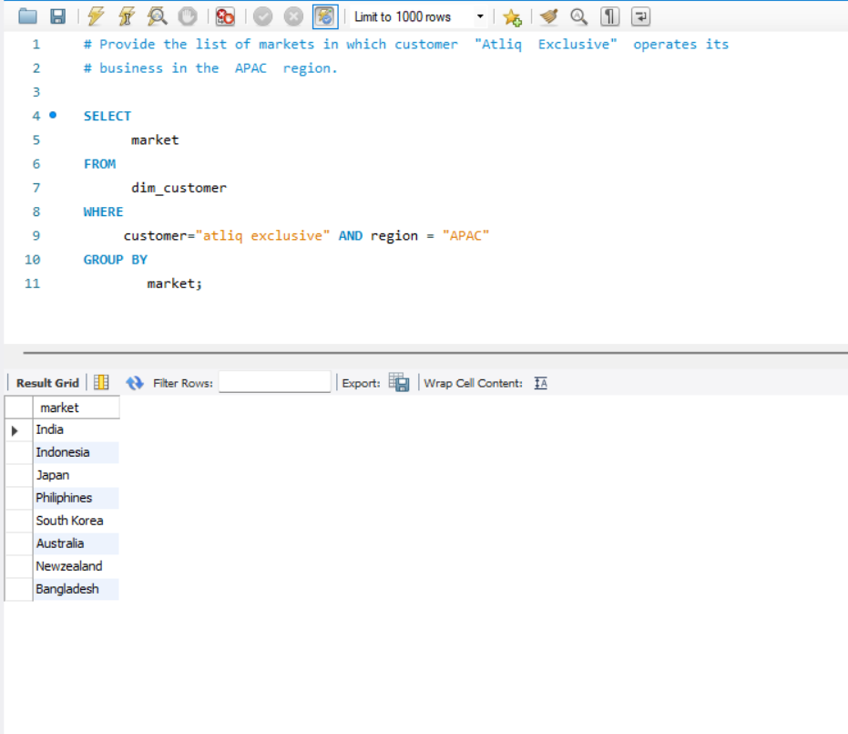
Question: Provide the list of markets in which customer 'AtliQ Exclusive' operates in the APAC region.
Insight
AtliQ Exclusive has strong presence across 8 key APAC markets

Slide 3
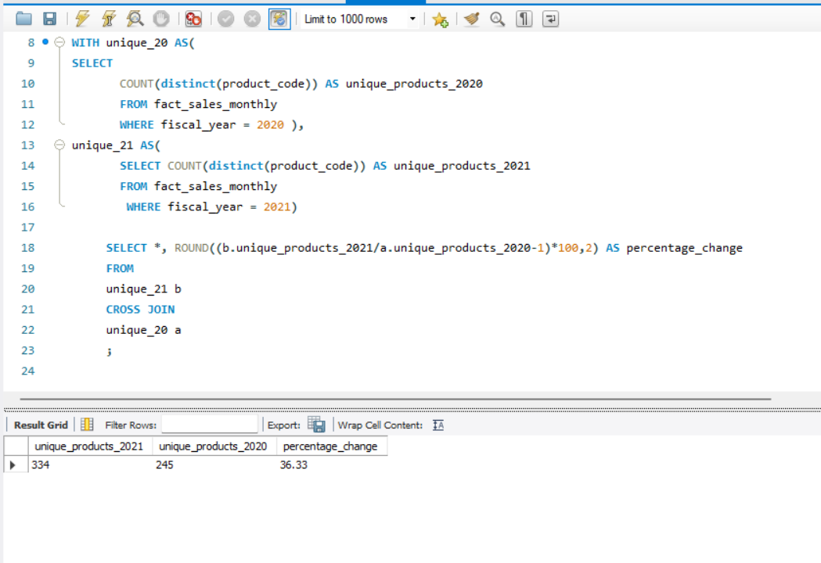
Question: How much product variety growth happened from 2020 to 2021?
Insight:
89 new products launched
YoY (+36%), strong portfolio expansion

Slide 4
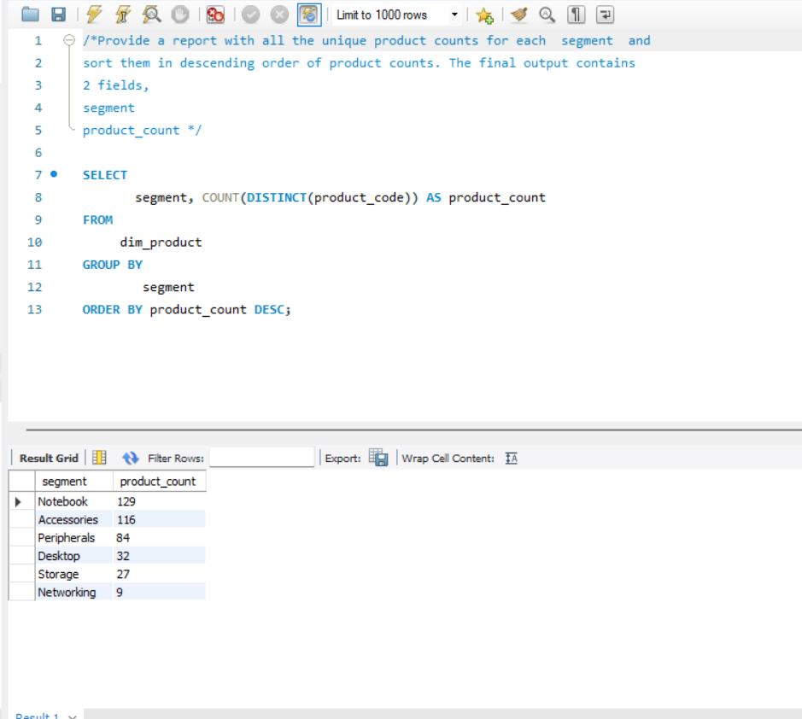
Question: What is the product variety in each segment?
Insight
Notebooks & Accessories comprise 62% of portfolio
(245 of 397 products)

Slide 5
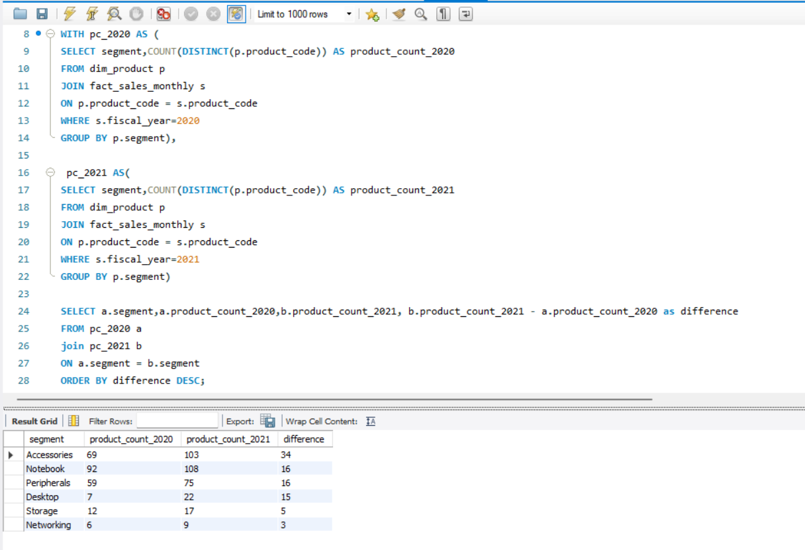
Question: Which product segments showed highest growth in variety (2020 vs 2021)?
Insight:
Accessories
(15% growth) and Notebooks
(17% growth) driving expansion

Slide 6
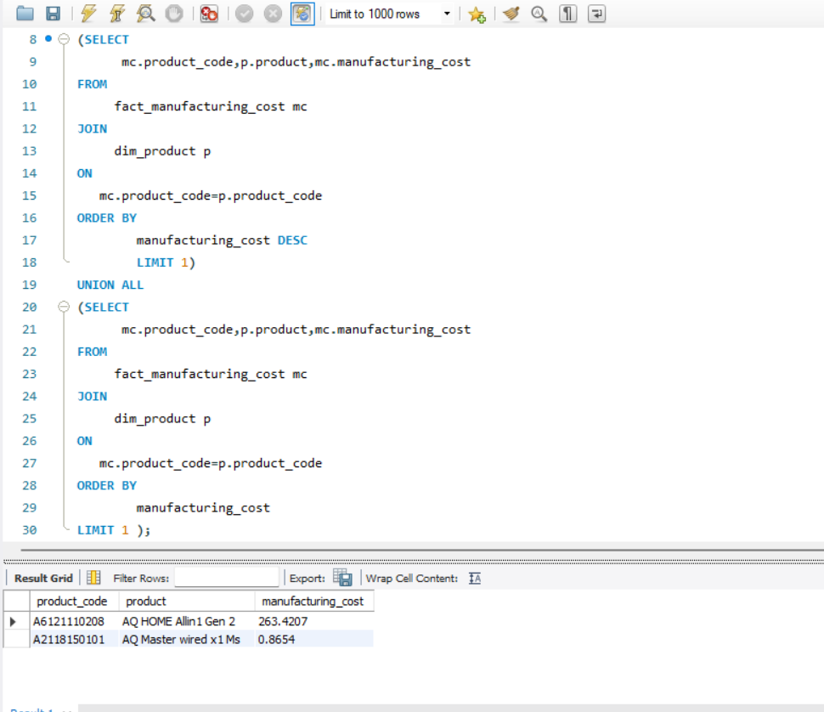
Question: What are the products with highest and lowest manufacturing costs?
Insight
Massive cost variance (300:1) between premium and budget products

Slide 7
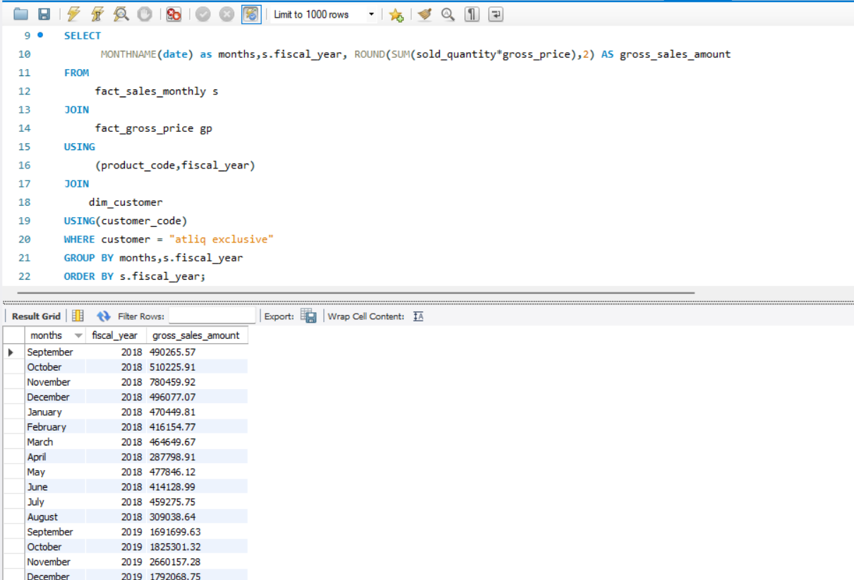
Question: What is the monthly gross sales trend for AtliQ Exclusive (2018-2019)?
Insight
YoY growth from 2018→2019 averages 240%,
November peak suggests seasonal buying

Slide 8
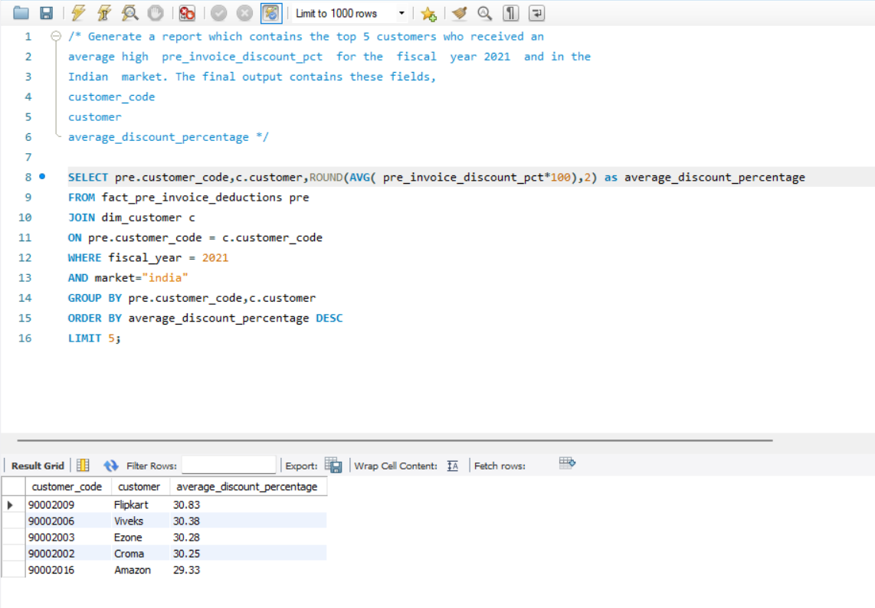
Question: Which top 5 customers received highest average pre-invoice discount in Indian market (FY 2021)?
Insight
Flipkart receives highest pre-invoice discounts in India market

Slide 9
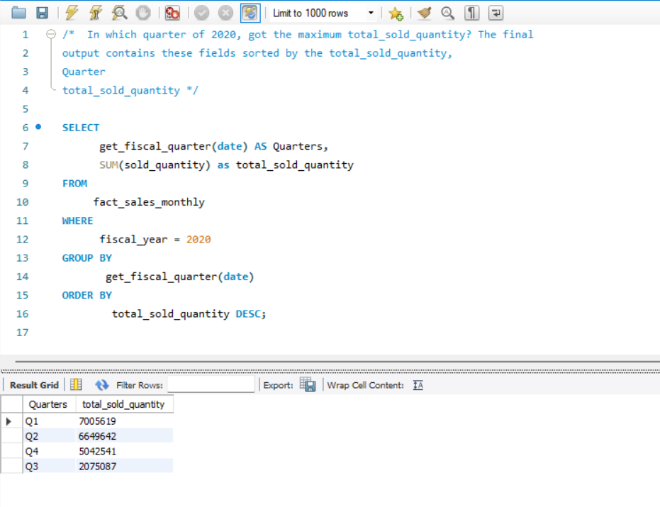
Question: In which quarter of 2020 got the maximum total sold quantity?
Insight
Q1 2020 had highest product sales
(7M units), representing 35% of annual volume

Slide 10
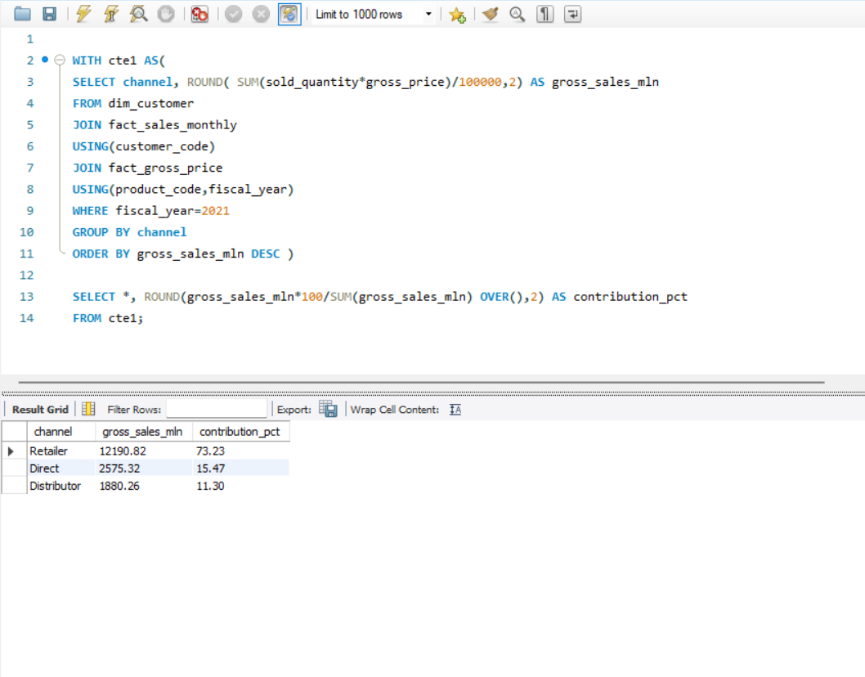
Question: Which channel brought more gross sales in FY 2021 and what is the percentage contribution?
Insight
Retail channel dominates with 73% of gross sales (₹12.2B), strategic focus area

Slide 11
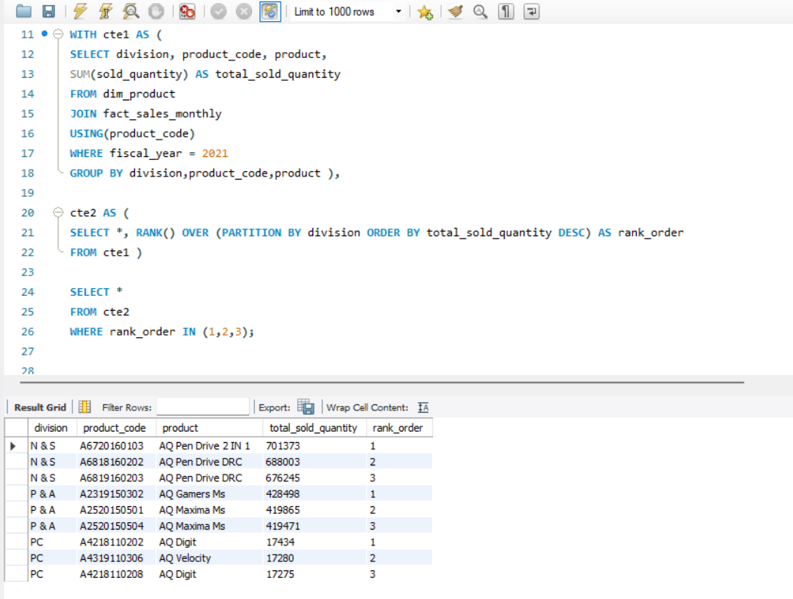
Question: What are the top 3 selling products in each division for 2021?
Insight
Pen drives lead N&S division;
Gaming mice dominate P&A

Slide 12
📌 KEY INSIGHTS SUMMARY
📈 Seasonality Trend: Q1 2020 recorded peak sales with 7M units, indicating a strong seasonal pattern.
🏬 Channel Performance: Retailer channel dominates, contributing 73% of gross sales (₹12.2B).
📦 Product Expansion: Product portfolio grew 36% YoY, expanding from 245 to 334 unique products.
🎧 Fastest-Growing Segment: Accessories segment led growth with +34 new products.
💾 Star Products: Pen drives emerged as top performers in the N&S division, exceeding 700K units sold.
🚀 Customer Growth: AtliQ Exclusive demonstrated strong momentum with 240%+ YoY growth.
🌏 Geographic Focus: Strategic presence across 8 key APAC markets for AtliQ Exclusive.

